Slide 1
SEE DESIGN
IMAGE SEARCH

Slide 2
2 WAYS TO SEARCH
REVERSE IMAGE SEARCH
CATEGORY WISE IMAGE SEARCH

Slide 3
REVERSE IMAGE SEARCH
IMAGE RESULTS APPEAR CHRONOLOGICALLY BASED ON SIMILARITY OF IMAGE SEARCHED
PERCENTAGE OF SIMILARITY IS BASED ON AREA COVERED BY THE SEARCHED IMAGE IN THE RESULT IMAGE
CAN FIRST SELECT CATEGORY AND THEN UPLOAD SEARCH IMAGE

Slide 4
CATEGORY WISE IMAGE SEARCH
VARIOUS CATEGORIES AVAILABLE
KEYWORDS COULD BE USED TO NARROW DOWN IMAGE RESULTS

Slide 5
IMAGE SEARCH CRITERIAS
Area covered by same/similiar image elements should be more than 50%.
Meaning similarity should be more than 50%.

Slide 6
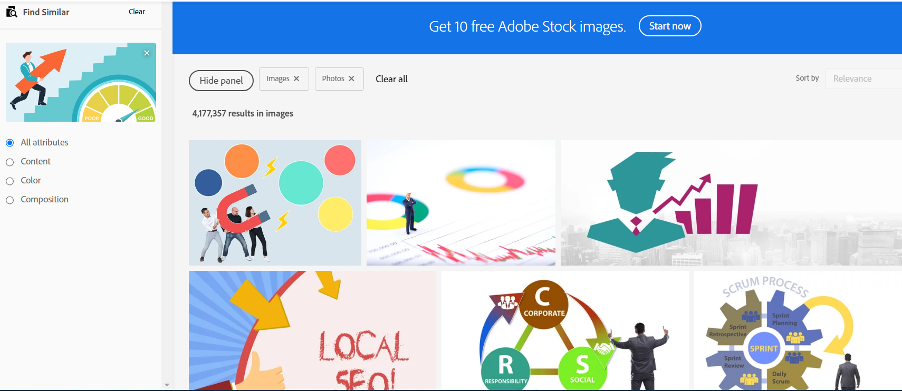
SAMPLE PRODUCT – ADOBE STOCK

Slide 7
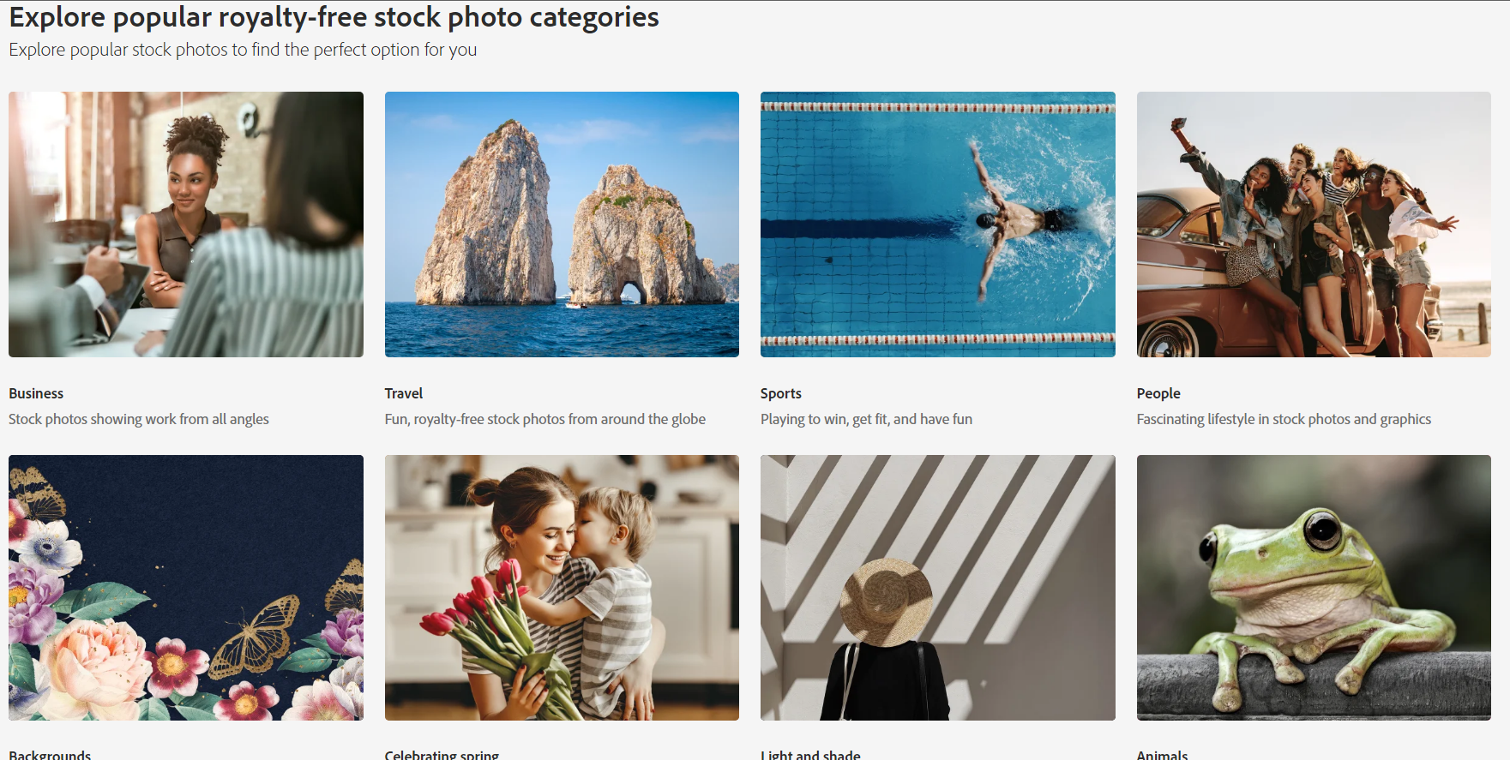

Slide 8
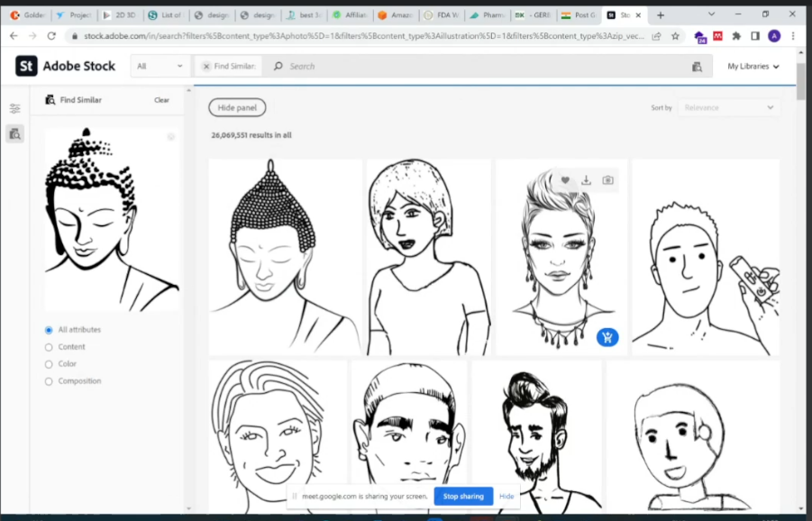
EXAMPLES

Slide 9
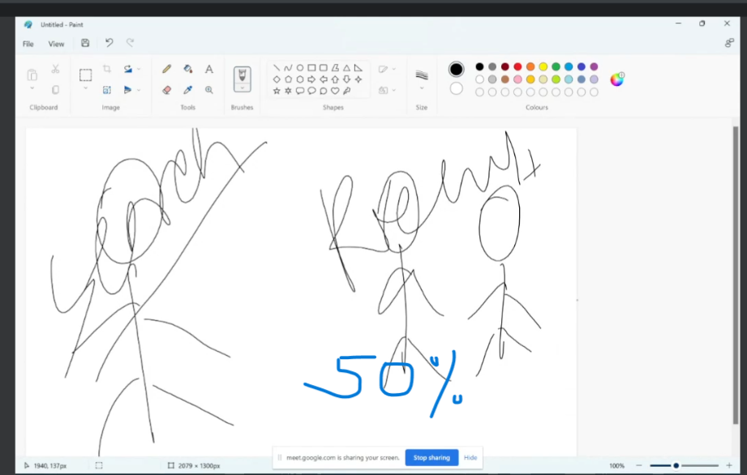
AREA COVERED BY SEARCHED IMAGE IS FULL SO 100% SIMILARITY
100%

Slide 10
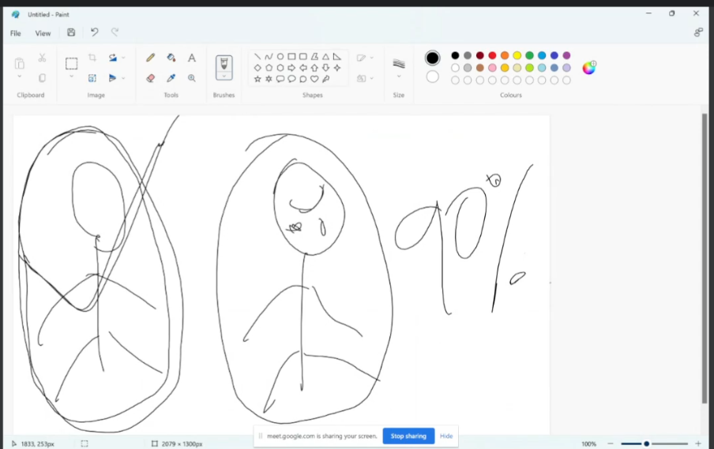
AREA COVERED BY SEARCHED IMAGE IS APPROX. 90%, HENCE THE SIMILARITY

